Slide 1



Slide 2

非谓语动词
铜陵一中 陈晨

Slide 3
说人话，非谓语到底是个啥？

Slide 17
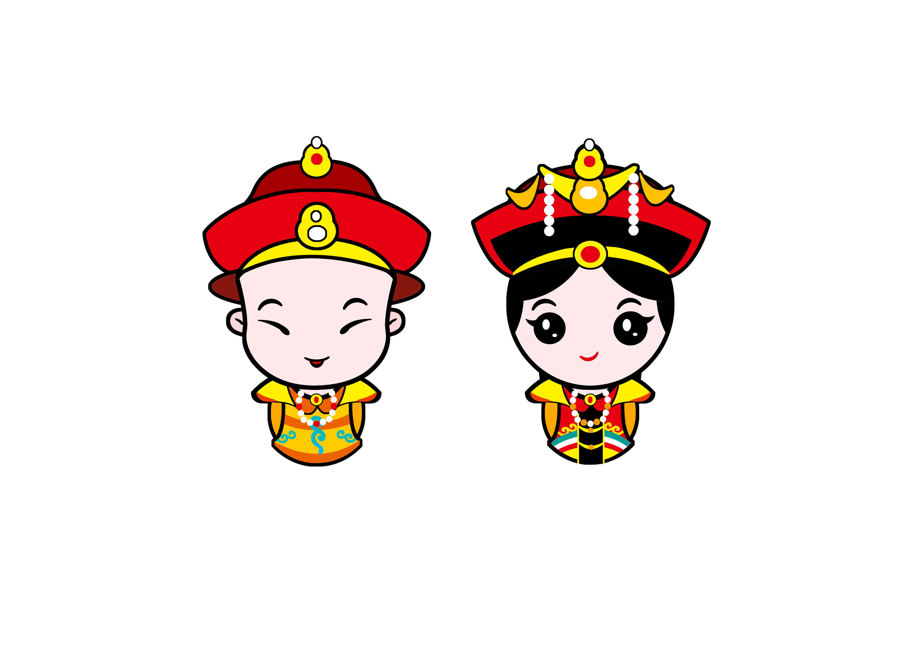
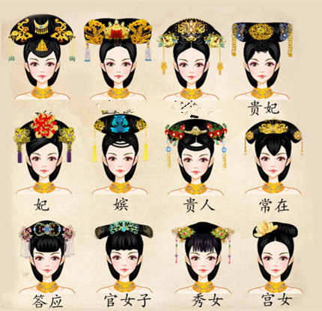
句子
以“.”为标准
皇上
谓语
皇后
动词
to do
doing
非谓语
done
三千佳丽

Slide 18
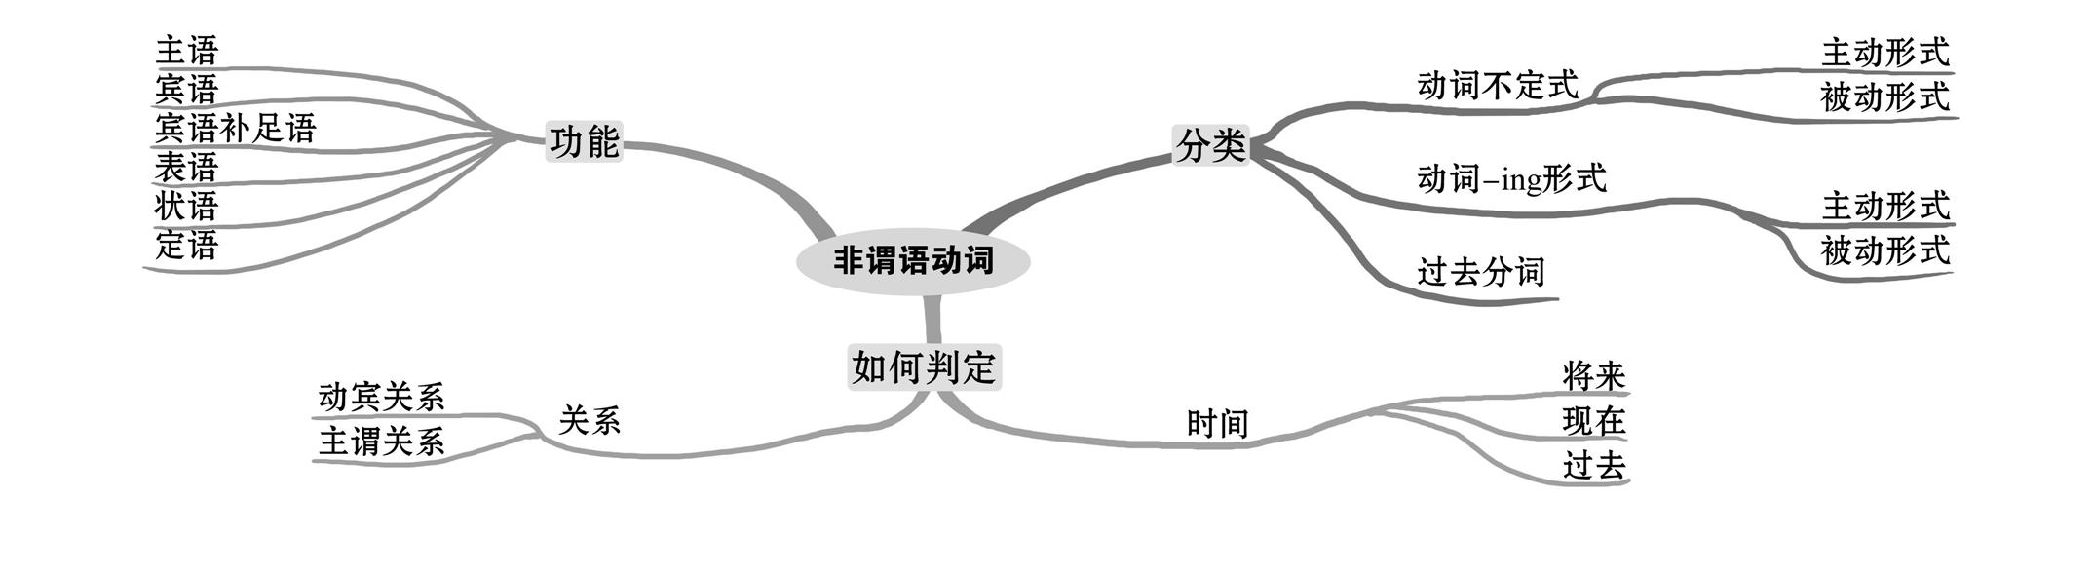
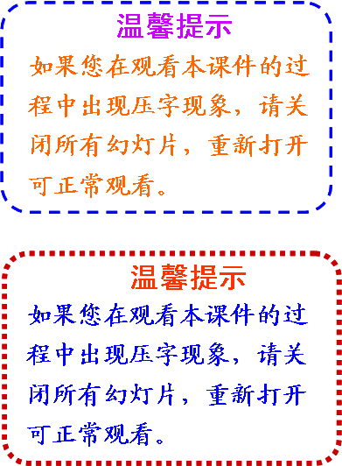

Slide 21
一：找谓语动词
解题
方法
Solution Methods
连=V-1
（连接句子的有效连词）
谓语
非谓语
连词：并列连词；从属连词
1. My cousin came to see me from the country,_________ (bring)me
a full basket of fresh fruits.
2. _________ (know) more words and expressions and you will find it easier to read
and communicate.
3. Daddy didn’t mind what we were doing, as long as we were together,__________
(have)fun.
4. Five people won the “China’s Green Figure” award, a title __________(give)
to ordinary people for their contributions to environmental protection.
5. Claire had her luggage ________(check) an hour before her plane left.
非谓语
连词=0；V=1
谓语
连词=1；V=2
非谓语
连词=2；V=3
非谓语
连词=0；V=1
非谓语
连词=1；V=2

Slide 22
空前名词
解题
方法
Solution Methods
二：找非谓语动词的逻辑主语
三：判断语态
被动 done
句子主语
主动 doing
宾语
1. My cousin came to see me from the country,_________ (bring)me
a full basket of fresh fruits.
2. _________ (know) more words and expressions and you will find it easier to read
and communicate.
3. Daddy didn’t mind what we were doing, as long as we were together,__________
(have)fun.
4. Five people won the “China’s Green Figure” award, a title __________(give)
to ordinary people for their contributions to environmental protection.
5. Claire had her luggage __________(check) an hour before her plane left.
bringing
主动
Know
having
主动
given
被动
checked
被动

Slide 23
尚未发生 to do
解题
方法
Solution Methods
四：分析时态
正在发生 doing
已经发生 done
之前发生 having done
1._______________ (fail) to reach them on the phone, we sent an email instead.
Having failed
连词=0；V=1
非谓语
主动
fail 在sent之前
2. The meeting ______________ (hold) now is of great importance.
being held
连词=0；V=1
非谓语
被动
hold动作正在发生
3. There are still many problems_____________( solve) before we are ready for a long stay on the Moon.
to be solvedo be solved
连词=1；V=2
非谓语
被动
solve动作尚未发生
4. The problem _________ (discuss) just now is of great importance.
discussedo be solved
连词=0；V=1
非谓语
被动
discuss动作已经发生

Slide 24
特殊
固定短语搭配
直接填空
1.________ (dress)in a white uniform, he looks more like a cook than a doctor.
2.______ (face)with so much trouble, we failed to complete the task on time.
3._________(Absorb) in his book, he didn't notice me enter the room.
4.________(tell) you the truth，I am a little tired.
5. As is known to us, it's no use ____________ (complain)without taking action.
6.Yan'an, a city ________ (locate) in northern Shaanxi Province, has seen great progress in its tourism industry over the past few years.
7. I avoided ___________(mention) the subject in case he should be offended.
Dressed
Faced
Absorbed
To tell
complaining
located
mentioning

